Slide 1
LandSlide Seekers
S. Shayan Mousavi M.,
Viktor Kapetanovic, Ray Lyu, Alexandre Pofelski

Slide 2
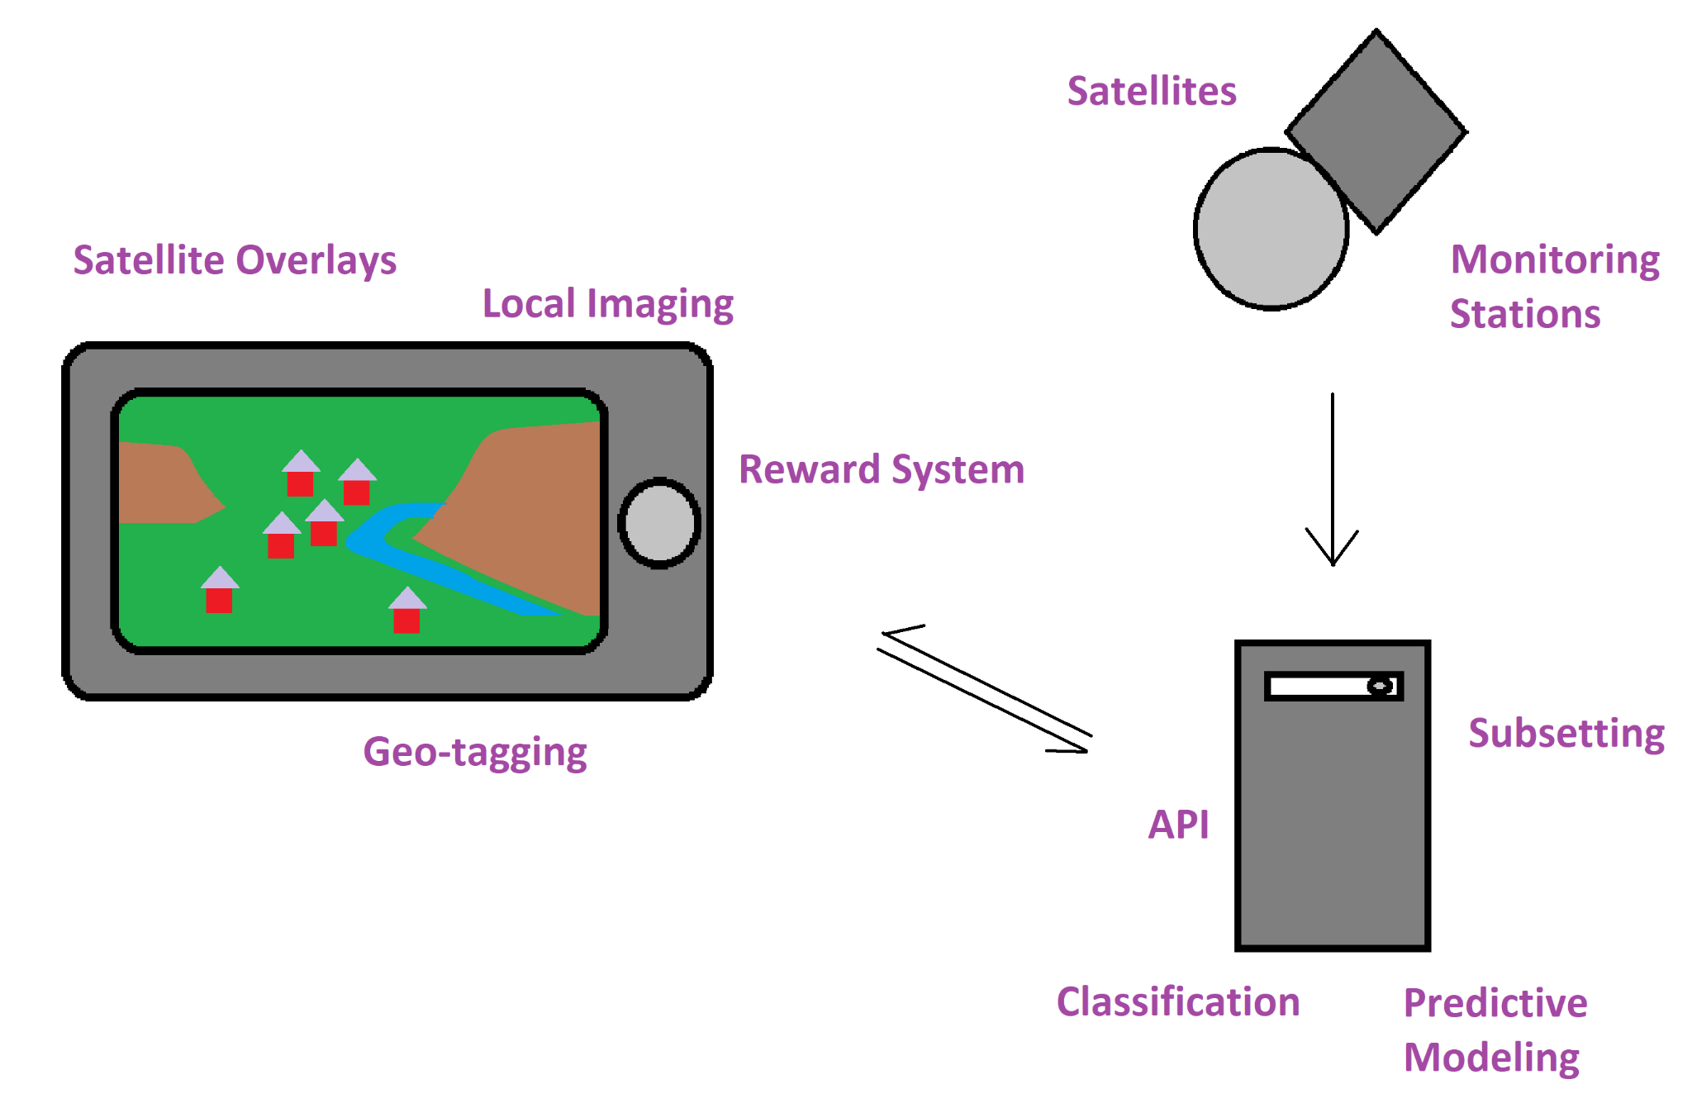
3 major components
NASA and other data
Smartphone application
Server for data analysis, transformation and ML training/evaluation

Slide 3
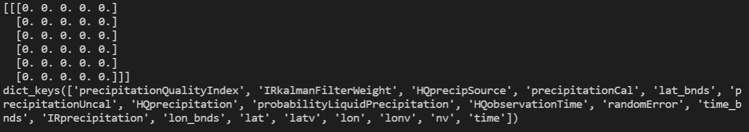
Data Extraction
Query satellite subset data and metadata from GPM_3IMERGHH_06 dataset

Slide 4
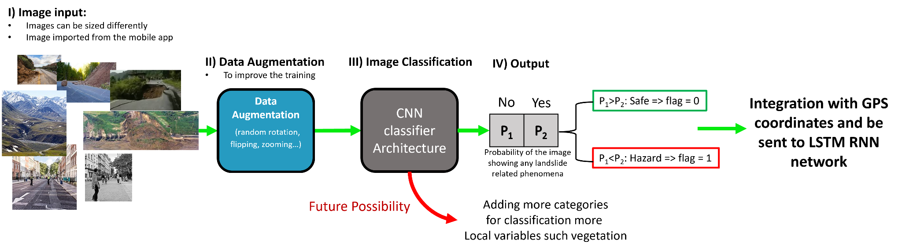
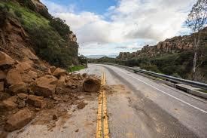
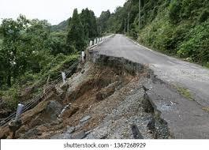
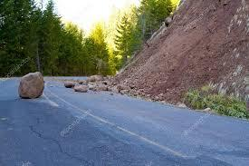
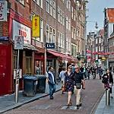
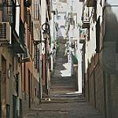
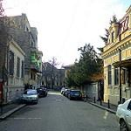
AI-driven Data Analysis
CNN Hazard Detection:
An example of images with their labels:
Hazardous
Hazardous
Hazardous
Safe
Safe
Safe
CNN calculated probabilities for image classification:
[0.38359815 0.73716843]
[0.24339736 0.97097695]
[0.64045346 0.37771377]
[0.65811867 0.31321263]
[0.9427512 0.1756418]
[0.36190346 0.6552297 ]
CNN classification results:
Hazardous, Flag = 1
Hazardous,
Flag = 1
Hazardous,
Flag = 1
Safe,
Flag = 0
Safe,
Flag = 0
Safe,
Flag = 0

Slide 5
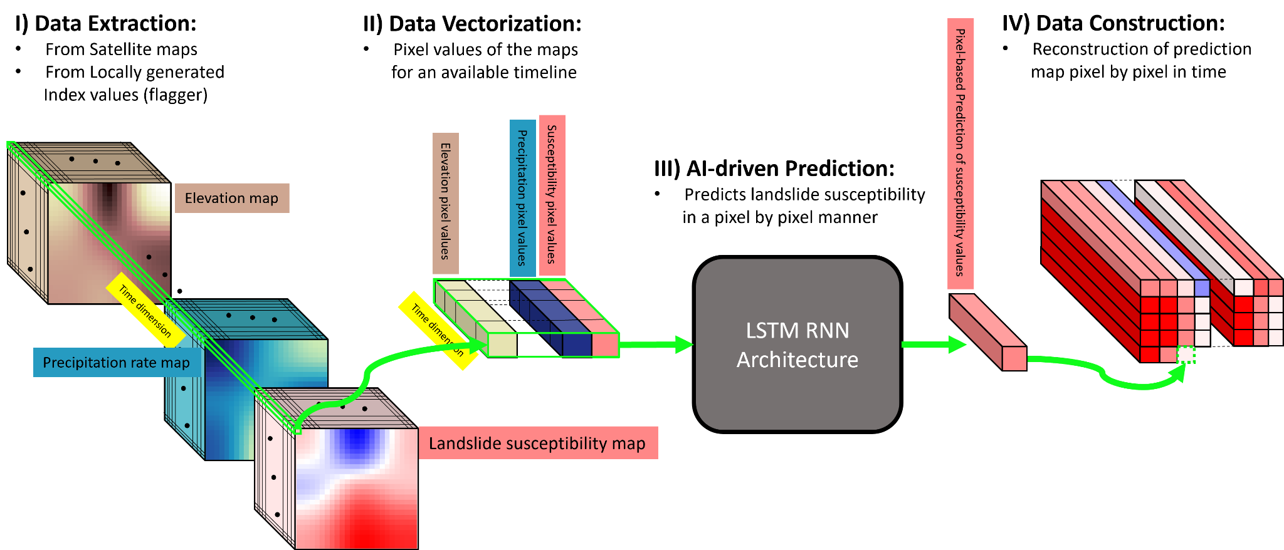
AI-driven Data Analysis
LSTM RNN landslide susceptibility prediction workflow:

Slide 6
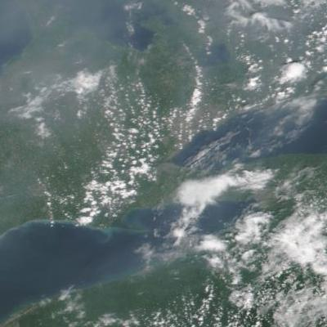
Data Visualization
Image
Soil moisture
Precipitation

Slide 7
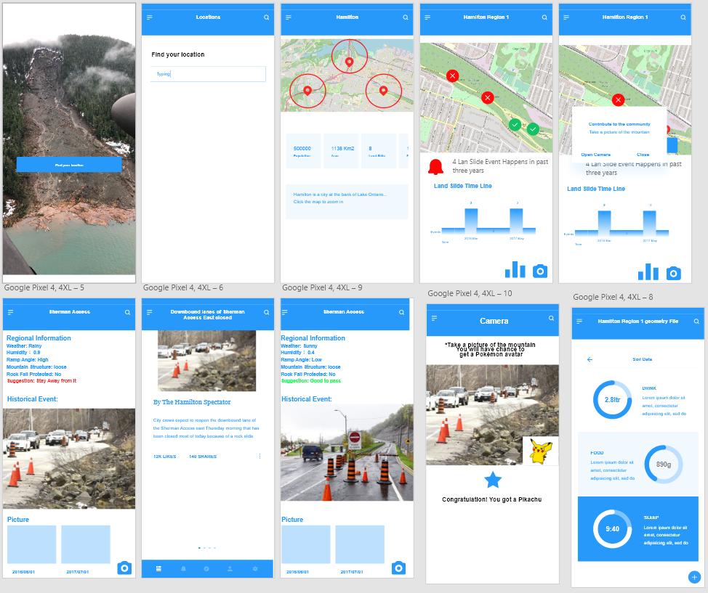
Data Visualization
Interactive phone app
Provide recommendations to local authorities for positioning sensors
Augmented reality game for collecting data

